Slide 1
MARKING SYSTEM OF YOUR GRADE
FINAL EXAM 30% (WRITTEN EXAM)
ONGOING 70% (SMALL WRITING TASKS)
BREAKDOWN OF ONGOING ASSESSMENT OVERALL SCORE /
ATTENDANCE 20 % / 14%
MID-TERM EXAM 20 % / 14%
QUIZ 1 GRAPH 20 % / 14%
QUIZ 2 ESSAY (TECHNOLOGY) 20 % / 14%
HOMEWORK 1 10 % / 7%
HOMEWORK 2 10 % / 7%
______ ______
100% (ongoing) / 70% 70/100%
--------------------------------------------------------------------------------------------------------------------
BREAKDOWN OF FINALS (30% OF OVERALL GRADE) /30% FINALS
FINAL WRITTEN EXAM 30 /100%
TASK 1 GRAPH + TASK 2 ESSAY (TECHNOLOGY) (OVERALL )
12% + 18 %

Slide 2

Keep in touch. WECHAT GROUP Any questions

Slide 3
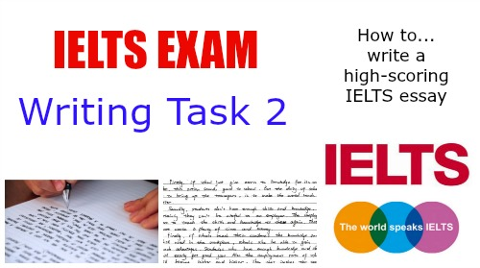
MID-TERM + FINAL EXAM
MID-TERM:
Writing– IELTS Writing Task 1
FINAL EXAM
Task 1 + Task 2

Slide 4

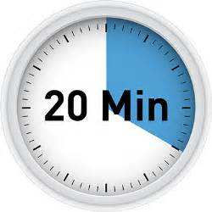
Task 1 + Task 2
Timing
The IELTS Writing test takes 60 minutes.
Spend 20 minutes on Task 1, at least 150 words
Spend 40 minutes on Task 2, at least 250 words

Slide 5
TASK 1 TYPES OF QUESTIONS WE WILL FOCUS ON
Line Graph
Bar Chart
Pie Chart
Table
Multiple chart and graph
Diagram & Maps
Process Diagrams

Slide 6
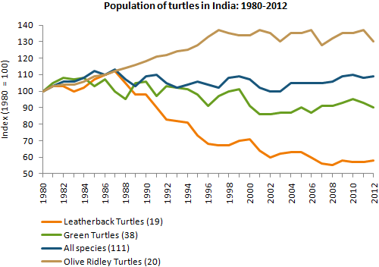
TASK 1 TYPES – (LINE) GRAPHS

Slide 7
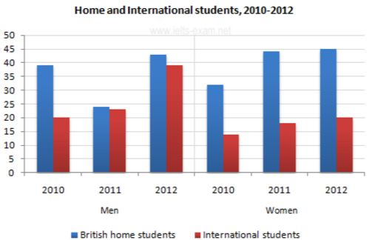
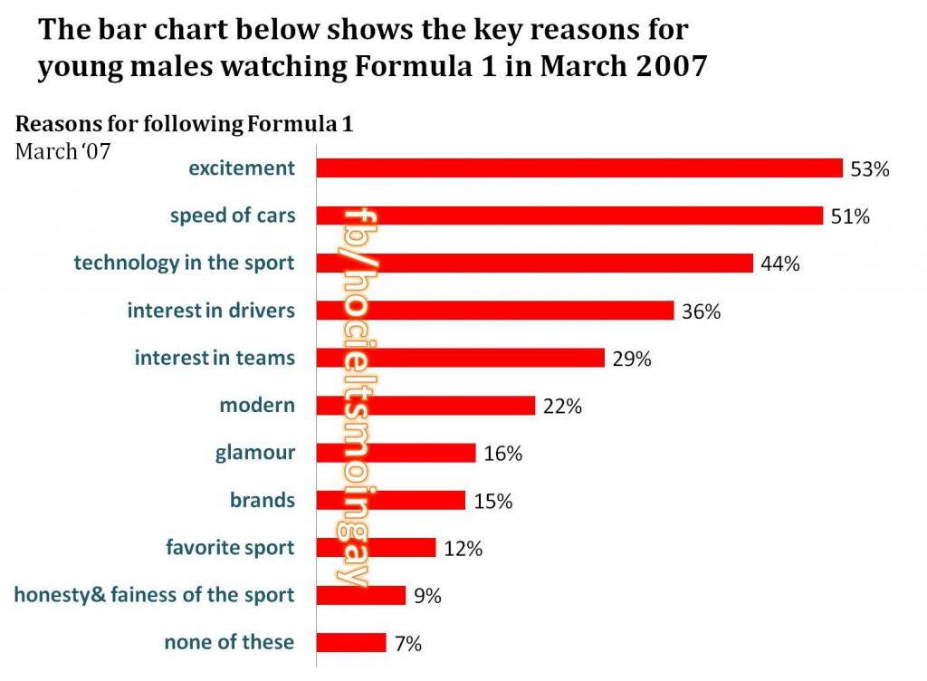
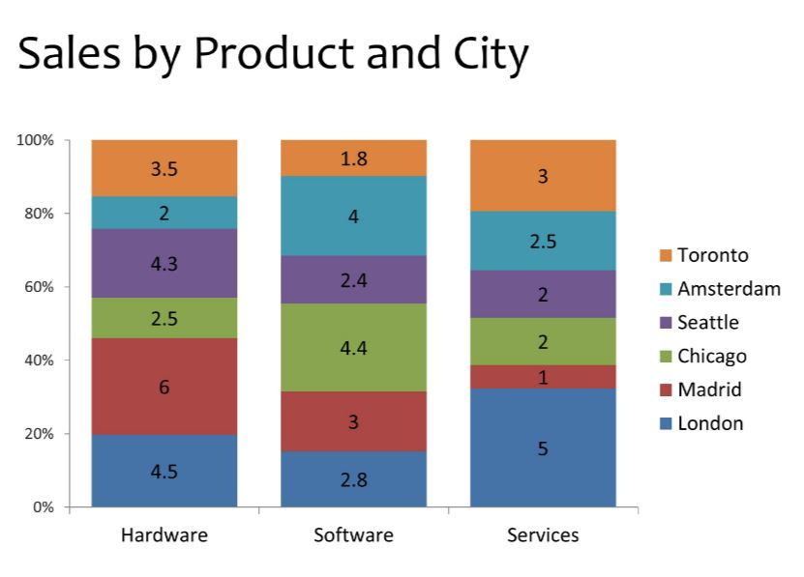
TASK 1 TYPES – BAR CHARTS

Slide 8
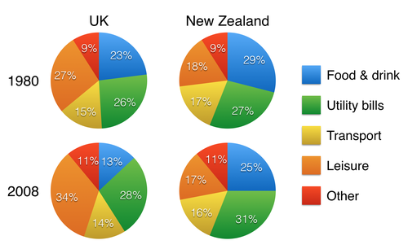
Pie Chart

Slide 9
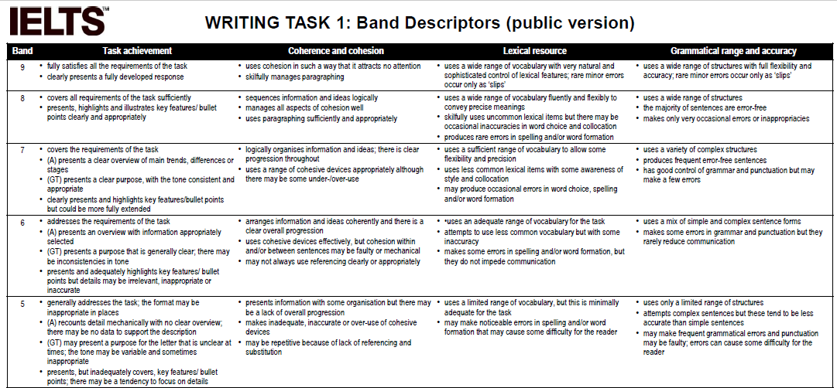
Task 1 Band Descriptors
Task Achievement (Answer the question)
Coherence and Cohesion (Flow / links/ logic)
Lexical Resource (Vocabulary)
Grammatical range (Grammar)

Slide 10
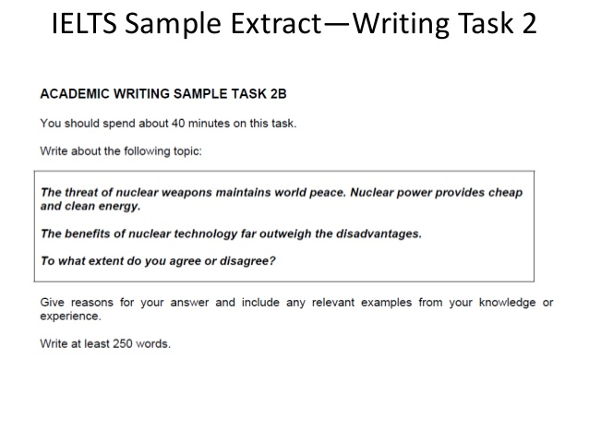
Task 2 Overview

Slide 11
TASK 2 ESSAY TYPES OF QUESTIONS
The types of Task 2 essays we will focus on are:
Opinion (Agree or Disagree)
Problem and Solution
Discussion /Discuss 2 views + (opinion)

Slide 12
TASK 2 TYPES - OPINION
Have newspapers become a thing of the past or do they still have an important role to play in people’s lives today?
Computers have made it possible for people to work from home instead of working in offices every day. This should be encouraged as it good for both workers and employers. To what extent do you agree or disagree?

Slide 13
Discuss Two Opposing Opinions
(opinion one) A growing number of people feel that animals should not be exploited by people and that they should have the same rights as humans, (opposing opinion) while others argue that humans must employ animals to satisfy their various needs, including uses for food and research. Discuss both views and give your opinion.

Slide 14
TASK 2 TYPES – PROBLEM AND SOLUTIONS
Overpopulation is a major problem in many urban centres around the world. What problems does this cause? How can we solve the issue of overpopulation?

Slide 15
Sample Task 2 Essay Questions by Topic: Technology
1. It is often claimed that electronic devices will soon replace paper books.
Do you agree or disagree?
2. Nowadays more and more people have access to the Internet. But constant availability of any information worsens people's memory and critical thinking skills.
To what extent do you agree or disagree?

Slide 16
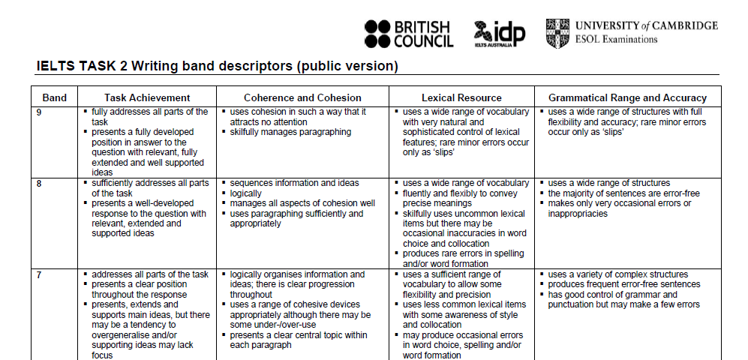
Task 2 Band Descriptors
Task Achievement (Answer the question)
Coherence and Cohesion (Flow / links/ logic)
Lexical Resource (Vocabulary)
Grammatical range (Grammar)

Slide 17
Why must you read?
If you do not read , your language remains too basic.
Example:
1. Technology is getting better and can be used everywhere
2. Technology is rapidly advancing and it has wide applications
Read and use it yourself flexibly
His English levels are rapidly advancing.
Learning English is beneficial due to its possible wide applications

Slide 18
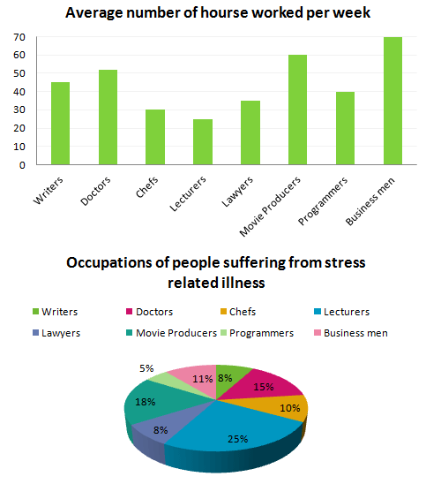
SAMPLE OF GOOD GRAPH DESCRIPTIONS
CAN YOU UNDERSTAND WHAT THESE SENTENCES MEAN?
The year 2010 showed some growth in regards to how many people were doing sport.
The average income further improved to a value of $20,000
Japan's figures are expected to decline marginally at the end of the time surveyed
Mobile phone users in Italy accounted for 20,000 individuals in 2010.

Slide 19
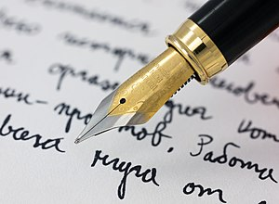
SAMPLE OF GOOD ESSAY ACADEMIC WRITING…
CAN YOU UNDERSTAND WHAT THESE SENTENCES MEAN?
The purpose of university education is far beyond job prospects
There are specific reasons why people believe that tertiary education is the gateway to a lucrative job
University education is definitely perceived as a means of better employability.
Urban residents’ travel can be facilitated.
High quality educational centers located in metropolitan zones generate advantages for city inhabitants to enjoy better educational opportunities
It is my personal view that crime prevention can be executed in various ways
The responsibility should lie with the government.

Slide 20
SAMPLE OF GOOD CREATIVE/DESCRIPTIVE WRITING…
The night was calm. The only sound that could be heard was that of the howling winds (personification)
After the death of my father, I spent several weeks drowned in a sea of grief (Metaphor)
He walks with pride and grace, performing a dance of disdain as he slowly lifts and lowers each paw with the delicacy of a ballet dancer.
---------------------------------------------------------------------------------------------------
Freundschaftsbezeigungen.
Dilettantenaufdringlichkeiten.
Stadtverordnetenversammlungen.
These things are not words, they are alphabetical horrors. And they are not rare; one can open a German newspaper at any time and see them marching majestically across the page –

Slide 21

Thank you

